Slide 1
TravelR: The R Journey in Expedia Group
27 November 2018

Slide 2



Introduction
TravelR: The R Journey in Expedia Group
Tsatska Enkhbayar
Senior Insight Analyst, Customer Analytics, Hotels.com
Jessica Zhou
Senior Business Analyst, Retail Analytics, Hotels.com
Lorraine Choi
Manager, Revenue Optimisation, Expedia Partner Solutions

Slide 3
A brief history of R at Expedia Group
TravelR: The R Journey in Expedia Group
In the beginning…
…To Today
RStudio running on a small Linux server underneath Lorraine’s desk
Few analysts using R in isolated islands across the team
Data is in the Cloud with an S3 data lake of over 5PB
RStudio deployment scaled for the Cloud - large EC2 instance types to support working with big data sets - over 5TBs of RAM and 320 CPUs for R workloads alone
R Connect supports Shiny dashboards as well as markdown documents, with 43k page views year to date
Notes:
R was brought in as a solution when SAS was decommissioned a year ago
5PB is how many copies of harry potter?
We worked closely with RStudio to set up our deployment which is blah blah

Slide 4

Scaling Analytics at Expedia Group with R
TravelR: The R Journey in Expedia Group
Still we faced some challenges!
Challenges
Mixture of R abilities and lack of onboarding/internal training
Complicated to get data in and out of R
Disparate themes and templates for visualisation
travelR
Solutions
Democratized R with internally taught courses
Easy plumbing put in place to connect R to our data lake
Standardized data visualization across the company
Created a community of R-users to share best practices, troubleshoot
The creation of the package-verse
Notes:
So we had this brand new, shiny and powerful tool BUT….we still had challenges
Democratisation of R through education (R for Analytics course, Intro to Machine Learning, Intro to Shiny) and creation of tools (packages)
That allowed us to scale R to a team of 100+ analysts and access a data lake of over 5 Petabytes
Standardised visualisation allowed us as Analytics to have a stronger brand image with our stakeholders
And in the process of doing this, we brought together everyone who was using R into a community which allows for knowledge sharing and troubleshooting with almost 200 people
We were able to do this all within one year – speed of implementation

Slide 5
Simplified Data Connection with Secured Credential Management
TravelR: The R Journey in Expedia Group
connectR Package
Wrapper functions to get and send data or commands from/to various data sources through R using JDBC
Credential Management
RStudio Environment: Use local and share vaults to manage personal and service account credentials
RStudio Connect Environment: Make use of environment variables to set credentials, which avoids republishing when credentials are changed

Slide 6
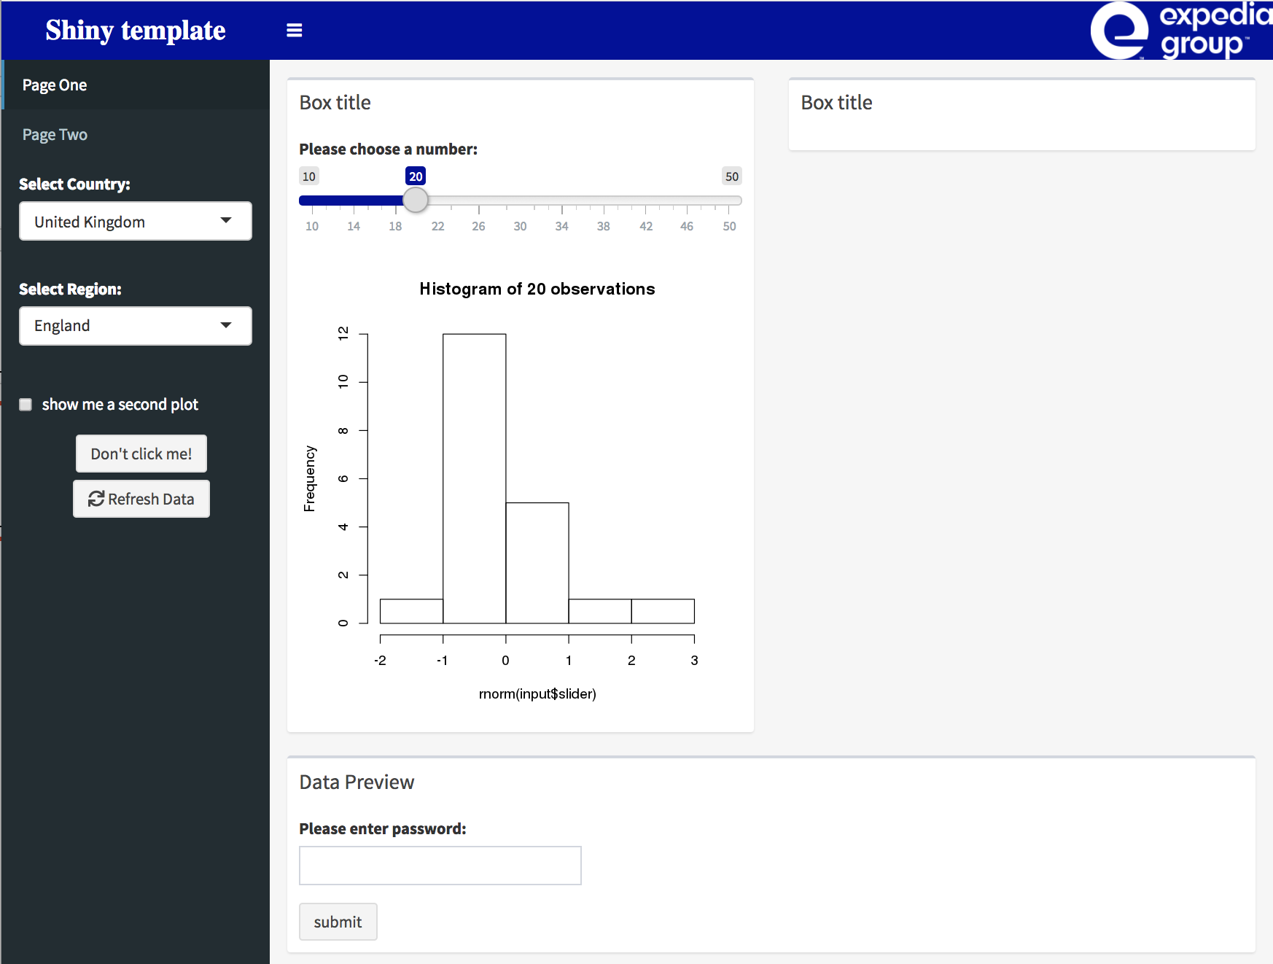
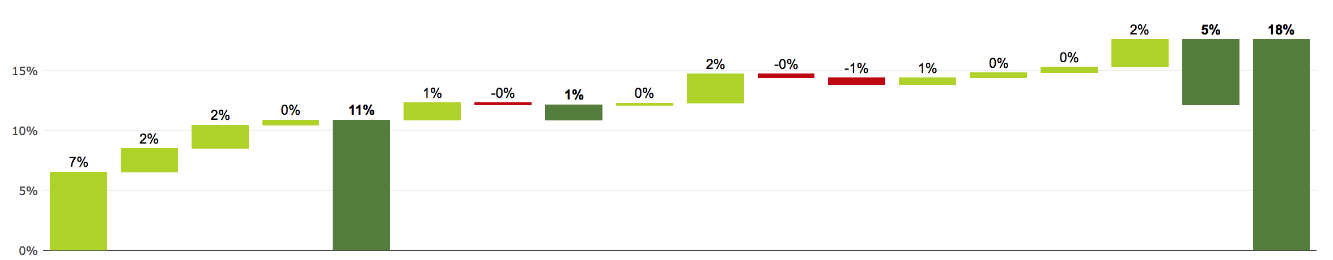
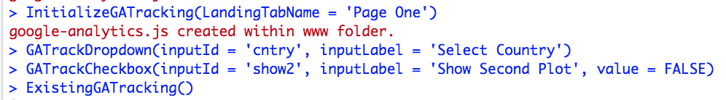
Standardizing visualization
TravelR: The R Journey in Expedia Group
VisualR Package
RMarkdown and R Shiny Templates
Formatting and Plotting Themes
Expedia Group Color palettes
Waterfall bar charts
Google Analytics Tracking

Slide 7
Challenges/Going forward…
TravelR: The R Journey in Expedia Group
Challenges we faced along the way
Ownership
Documentation / JIRA
Git / contributing to packages
What next?
Teaching sessions: how to use/how to contribute
Apply more software development approach in maintenance
Process to open source TravelR
Notes:
Jess:
We’re launching and working on branding, developing stickers

